Slide 1
CUSTOMER RESEARCH AND MARKET INSIGHT ANALYTICS
CUSTOMER SHOPPING TRENDS ANALYSIS USING PYTHON
PRESENTED BY
FRANCIS NZUBECHUKWU CHUKWUNONYERE

Slide 2
PROJECT OVERVIEW
Analyze customer shopping data
Understand customer behaviour
Identify purchasing patterns
Generate business insights
Recommend business strategies

Slide 3
DATASET OVERVIEW
Dataset: shopping_trends.csv
Variables
Age
Gender
Location
Category
Purchase Amount
Review Rating
Payment Method
Subscription Status
Tools
Python
Pandas
NumPy
Matplotlib
Seaborn

Slide 4
DATA INSPECTION
Loaded the dataset
Checked dataset dimensions
Reviewed data types
Identified missing values
Checked duplicates
Generated summary statistics

Slide 5
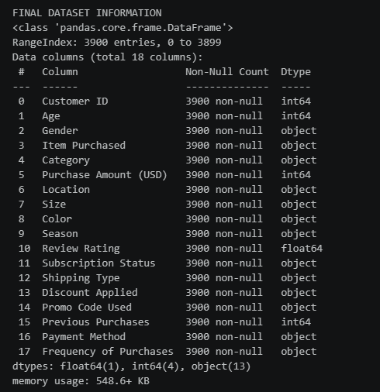
Fig 1: Preview of the cleaned dataset

Slide 6
DATA CLEANING
Removed duplicates
Removed missing values
Standardized gender
Standardized locations
Converted data types
Removed unrealistic ages

Slide 7
EXPLORATORY DATA ANALYSIS (EDA)
VISUALIZATIONS
Age Distribution
Review Ratings
Average Spending by Gender

Slide 8
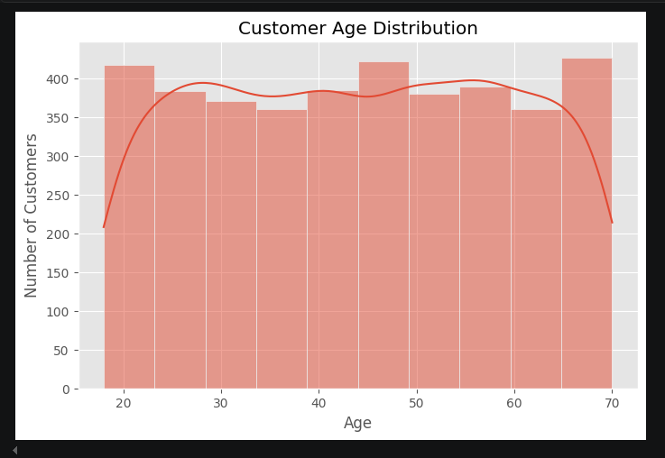
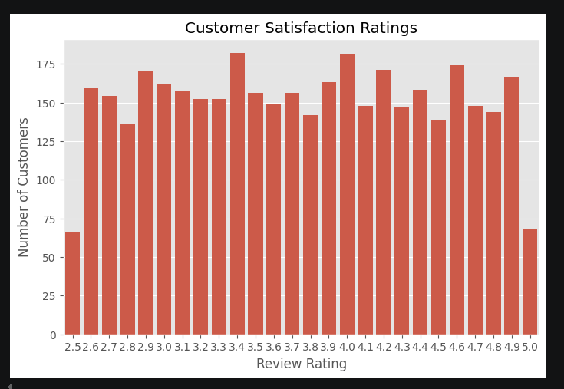
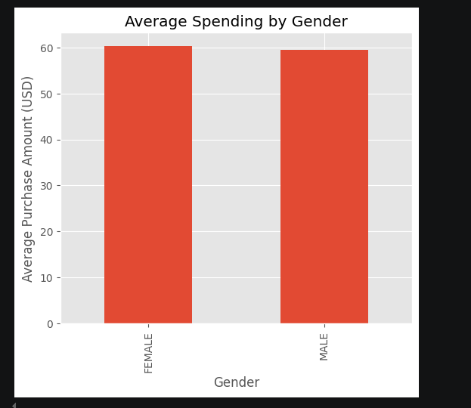
Fig 2: Customer age distribution
Fig 3: Customer satisfaction ratings
Fig 4: Average spending by gender

Slide 9
CUSTOMER BEHAVIOUR
VISUALIZATIONS
Age vs Purchase Amount
Customers by Location
Payment Method

Slide 10
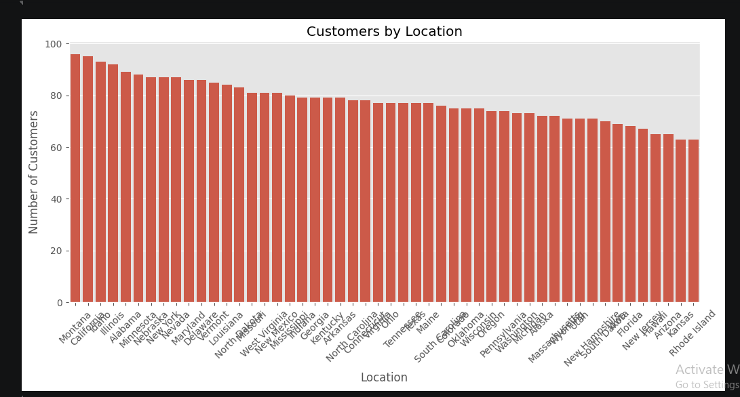
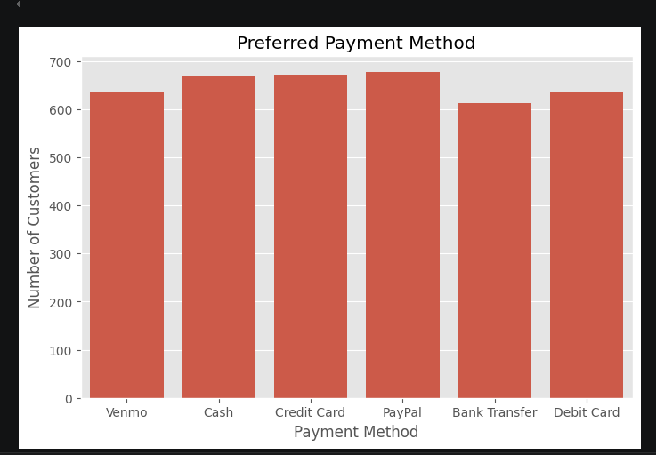
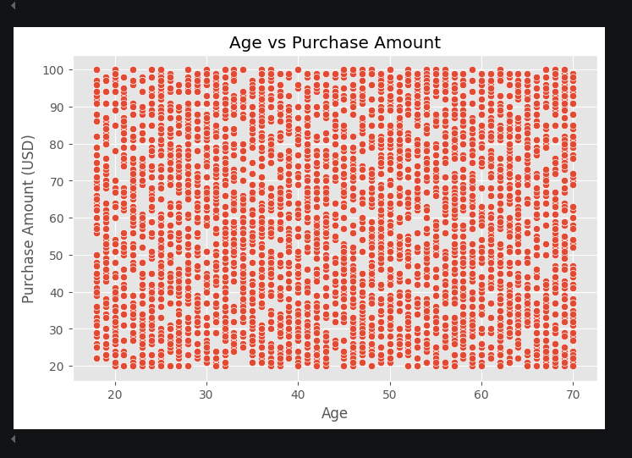
Fig 5: Customer distribution by location
Fig 6: Preferred payment method
Fig 7: Age VS. Purchase Amount

Slide 11
ADDITIONAL ANALYSIS
VISUALIZATIONS
Correlation Heatmap
Subscription Status
Product Categories

Slide 12
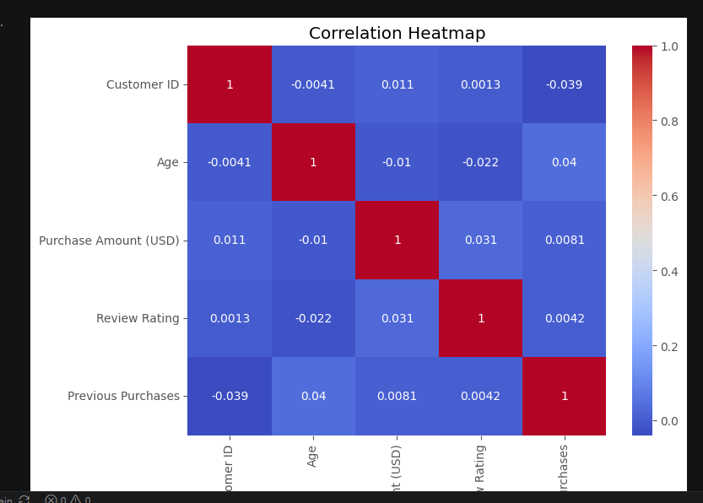
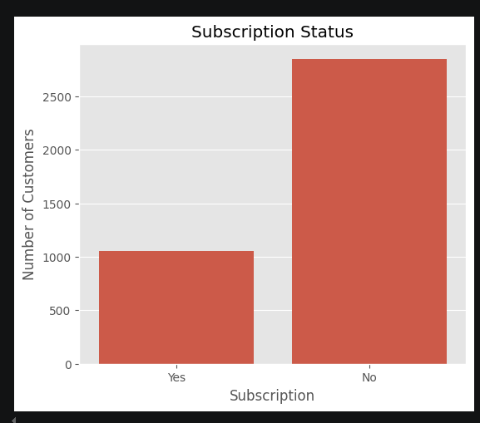
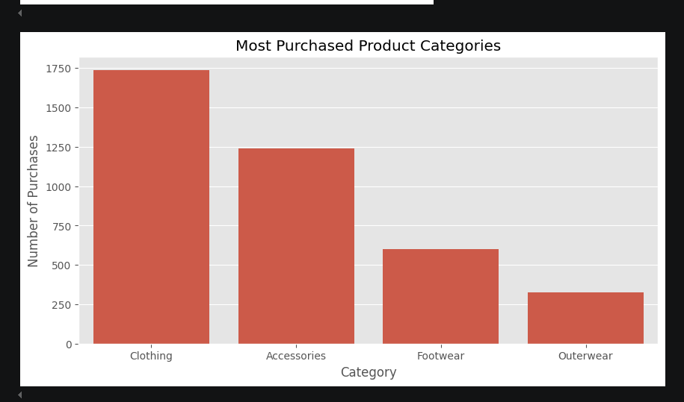
Fig 8: Correlation Heatmap of Numerical Variables
Fig 9: Customer Subscription Status
Fig 10: Most purchased product category

Slide 13
KEY FINDINGS
Spending varies across customers
Customer distribution differs by location
Popular payment methods identified
Subscription indicates engagement
Product preferences vary

Slide 14
BUSINESS RECOMMENDATION
Target high-spending customers
Promote subscriptions
Expand in key locations
Stock popular products
Improve customer satisfaction

Slide 15
CONCLUSION
Dataset successfully analyzed
Customer trends identified
Business insights generated
Recommendations provided

Slide 16
THANK YOU FOR LISTENING

